Slide 1







A SINGLE SPARK CAN IGNITE THE BLAZE OF INNOVATION
IGNITRON 2026
: Fueling Entrepreneurial Spirit
Welcome, innovators and dreamers! Prepare to transform your boldest concepts into tangible success stories.

Slide 2

Unleash Your Vision!
Are you ready to turn your groundbreaking ideas into reality? Join us at 'Fueling the Entrepreneurial Spirit' where creativity meets unparalleled opportunity!
Innovate
Connect
Bring your unique solutions
Network with industry leaders
Grow
Unlock your business potential

Slide 3

Competition Guidelines
To ensure a fair and inspiring environment for all participants, please familiarize yourself with the rules and regulations of the IGNITRON 2026 competition.
•Fair Play: Uphold ethical standards in all aspects of your submission.
•Originality: All ideas must be your own work, free from plagiarism.
•Respect: Maintain a respectful and constructive attitude throughout the event.
•Adherence: Follow all submission deadlines and format requirements.

Slide 4




Step 1: Ideate & Innovate
Step 2: Craft Your Compelling Story
Start with a spark! Develop a unique business idea that addresses a genuine real-world problem. Focus on solutions that demonstrate significant growth potential and can truly make a difference.
Your idea deserves a spotlight. Create an engaging presentation that vividly communicates your vision, problem-solution fit, and competitive advantage. Your story should captivate and convince.
•Problem-Solving: Identify a clear market need.
•Originality: Showcase a fresh perspective.
•Scalability: Outline its potential for expansion.
•Value Proposition: Clearly define what you offer.
•Market Insight: Demonstrate understanding of your audience.
•Visual Impact: Use compelling design to enhance your message.
Step 3: Screening for Success
Step 4: Grand Showcase & Rewards
Submit your presentation for an initial rigorous evaluation. Judges will assess your idea based on its creativity, innovation, potential impact, and overall feasibility. Only the best will proceed!
The moment of truth! Pitch your refined business model canvas to a distinguished panel of judges and a live audience. This is your chance to win prizes, secure mentorship, attract funding, and forge invaluable industry connections.
This competition is more than just a chance to win; it's an opportunity to develop entrepreneurial skills, gain valuable feedback, network, and empower yourself to turn your dream into reality.

Slide 5
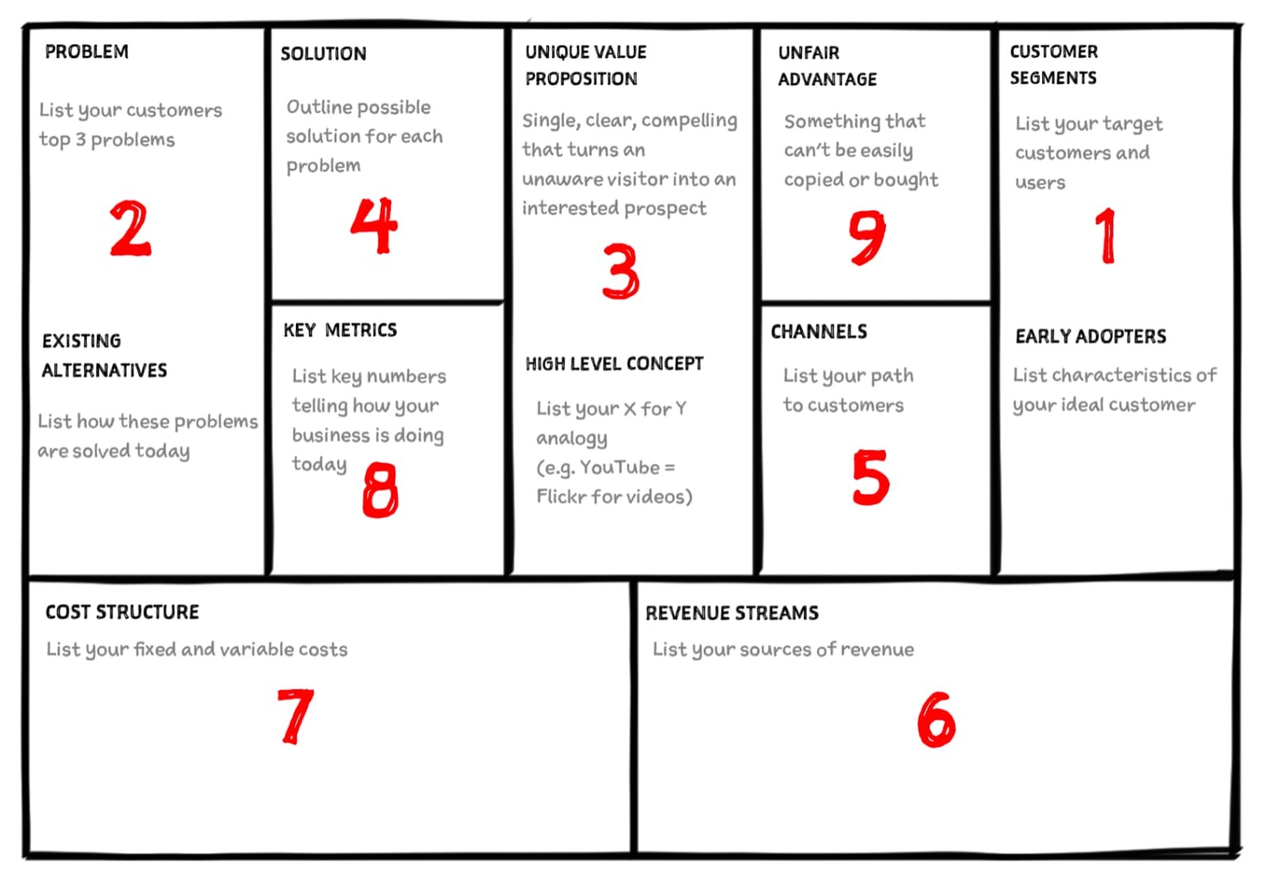
Winner's tips

Slide 6

Don't Miss Out!
Submission Deadline: 16/02/2026
Mark your calendars! Ensure all your materials are submitted on time to be considered for IGNITRON 2026. This is your chance to shine and make your entrepreneurial dreams a reality.
Late submissions will not be accepted. Plan ahead to ensure your entry is complete and submitted by the deadline.

Slide 7
Essential Requirements for Participation
To ensure a smooth registration process, please provide the following details:
Team Name
Team Co-Ordinator Name
Co-Ordinator Phone Number
Alternative Phone Number
Co-Ordinator Email ID
Alternative Email ID
Team Size (2-5 members)
•College Name
•Your Business Idea (brief description)
•Payment Method Used
•Payment Screenshot (proof of payment)
•Your Idea Presentation (PPT format)

Slide 8

Key Elements for Your Winning Presentation
Craft a comprehensive presentation that covers these critical aspects of your business idea. A well-structured pitch will highlight your vision and strategy
Executive Summary
Industry Overview
A concise overview of your entire business plan, capturing its essence and potential
Demonstrate your understanding of the market, including trends, size, and target segments.
Marketing & Competition
Operational Plan
Outline your strategy to reach customers and how you stand out from competitors.
Detail how your business will function day-to-day, from production to delivery.
Financial Plan
Present your financial projections, funding needs, and revenue model.
For any queries, please contact our student coordinators.
Email your presentations to: cie@vjim.edu.in

Slide 9

The Anatomy of a Business Idea
What
When
The problem and solution
Start plan and launch date
Why
Who
Goals and purpose
Founder and target buyer

Slide 10


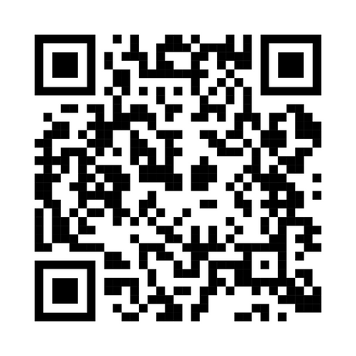

Faculty Coordinator
Dr. Vishal Kutchu
Student Coordinators
Sri Vatsava 9392067800
G.Anusree 9502211025
T. Sai Teja 9392067800
Registration fees Rs 1000/-
PRIZE MONEY: RS 50,000/-

